Slide 2
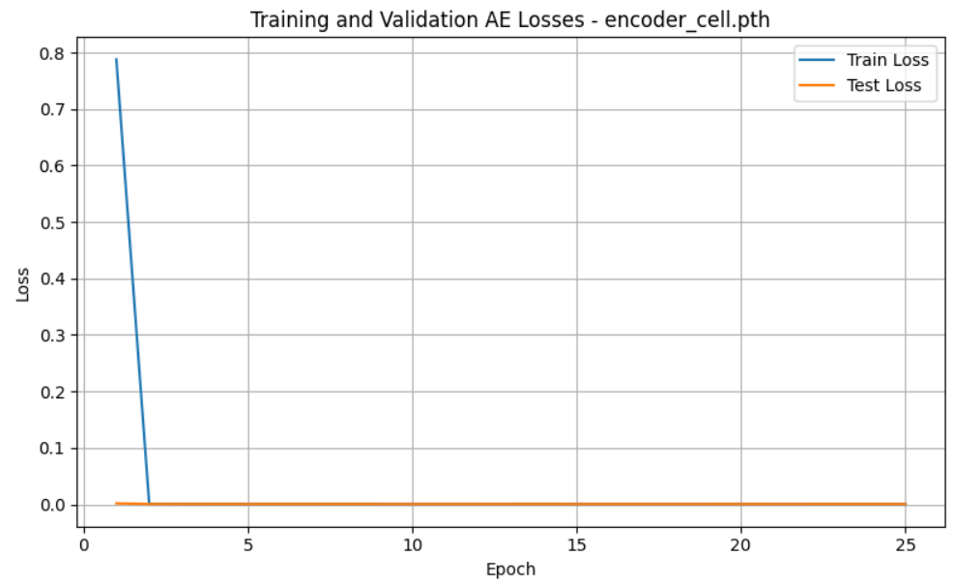
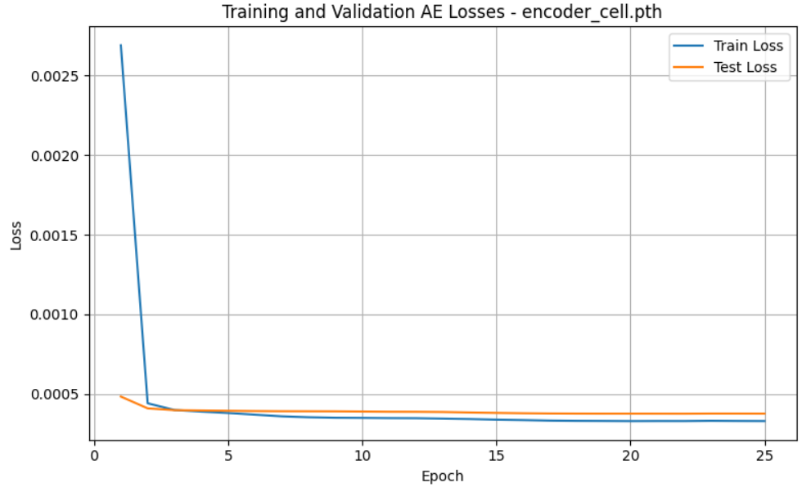
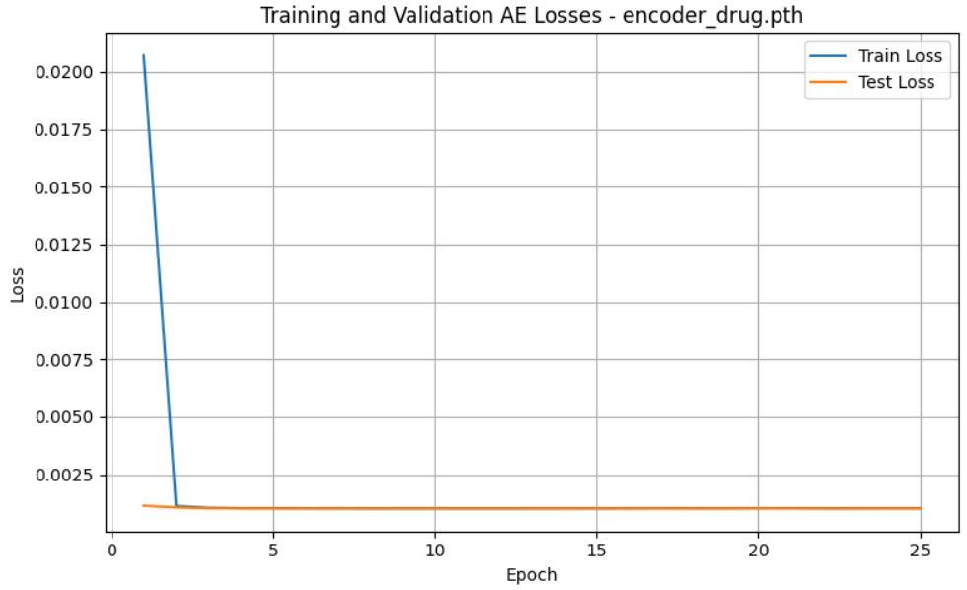
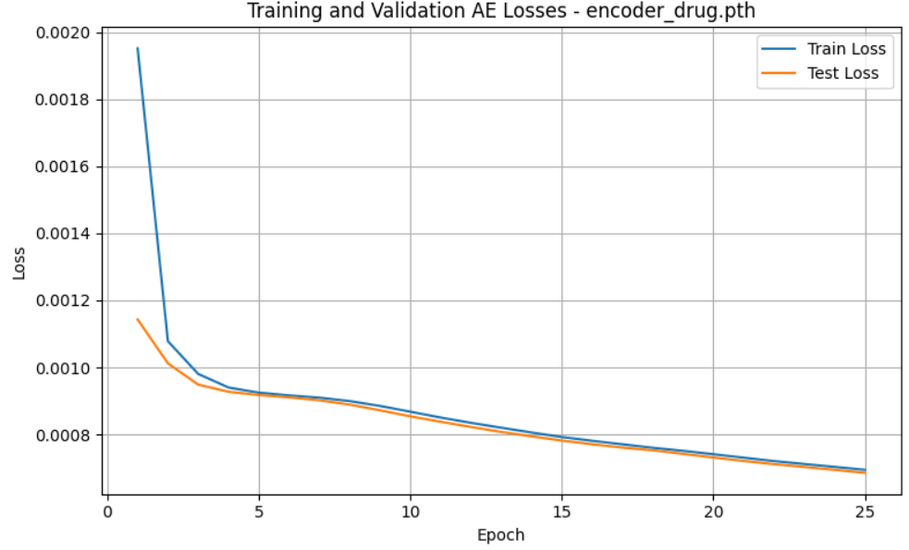
Learning rate from 10⁻² to 10⁻³
Lr = 10⁻²
Lr = 10⁻³
⚠️Training loss drops drastically from 0.8 to ~0.0008 in just 2 epochs
And loss plateau very early
✅ initial loss is lower and drop is more progressive and smoother
⚠️similar pattern : loss quickly drops, then flattens : learning saturates too soon
✅ Same improvement: smoother decrease and final loss is lower

Slide 3
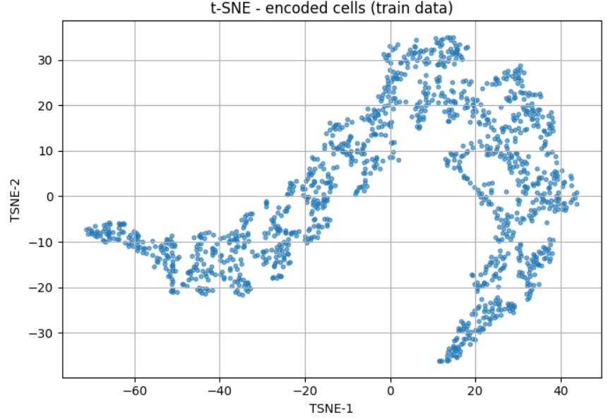
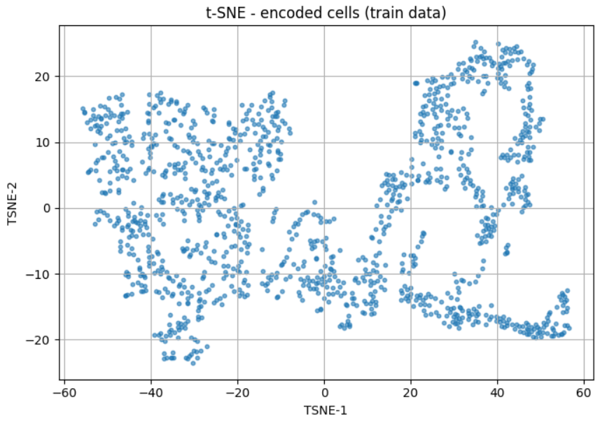
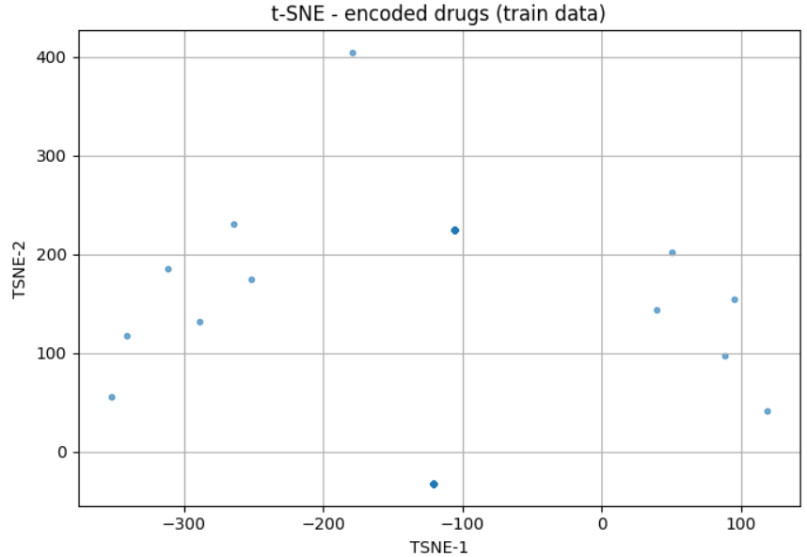
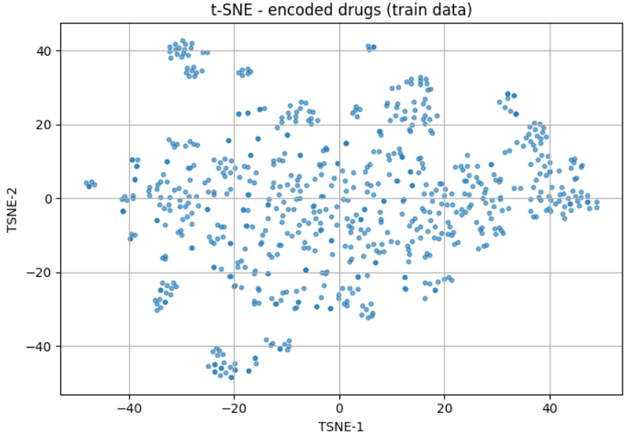
Learning rate from 10⁻² to 10⁻³
Lr = 10⁻²
Lr = 10⁻³
z_cell std: 0.95
z_cell std: 28.74
⚠️High std, t-SNE plot shows curved and compressed datapoints.
✅ cell latent space is better structured : Well spread + clusters
z_drug std: 1.5
z_drug std: 0.064
⚠️ low std, t-SNE plot shows sparse and collapsed points.
✅ Better spread and clusters
Notes:
Lower lr → more stable training and better latent spaces.
❐ Try learning rate schedulers (a tool that automatically changes the learning rate during training depending on a rule or condition, e.g., ReduceLROnPlateau) ?
❐ or a warm-up phase (at the beginning of training, start with a very small lr, then gradually increase it to the target value) ?
Early stopping (a regularization technique where you stop training if the validation loss stops improving after a certain number of epochs)
+ patience (stop training if val loss does not improve for x consecutive epochs). → Prevent overfitting

Slide 4
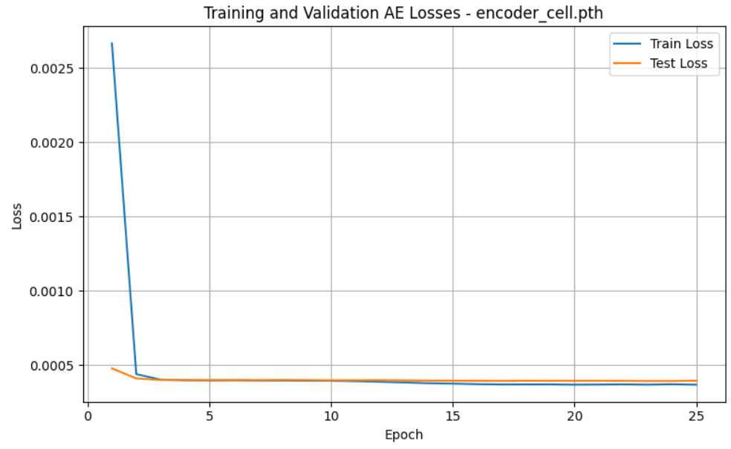
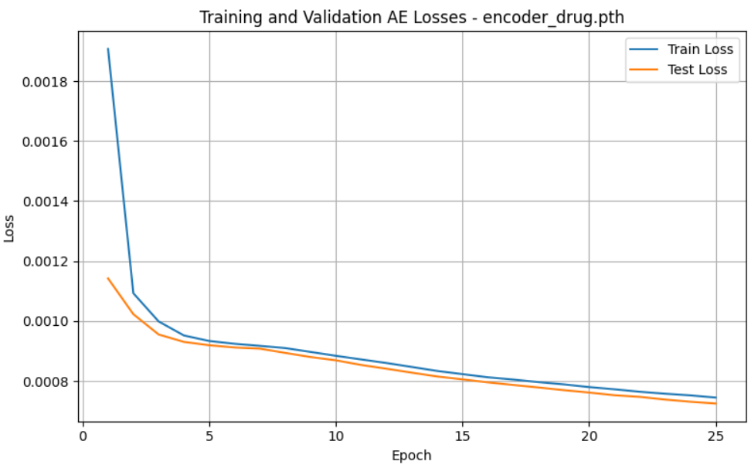
Dropout regularization
Learning rate = 0.001
Weighted MSE, alpha = 1
Tensor normalized
No Dropout
Latent dim 50/50
Learning rate = 0.001
Weighted MSE, alpha = 1
Tensor normalized
Dropout 0.1
Latent dim 50/50
None
0.1
No diff ?
Notes:
Pas de diff notable

Slide 5
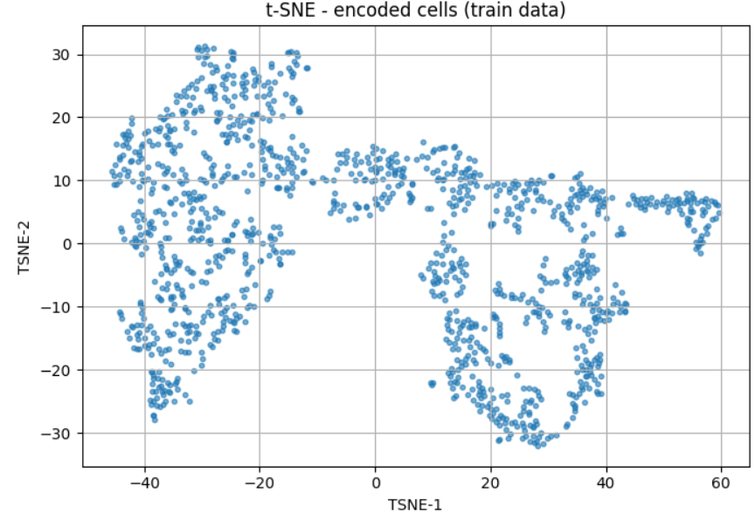
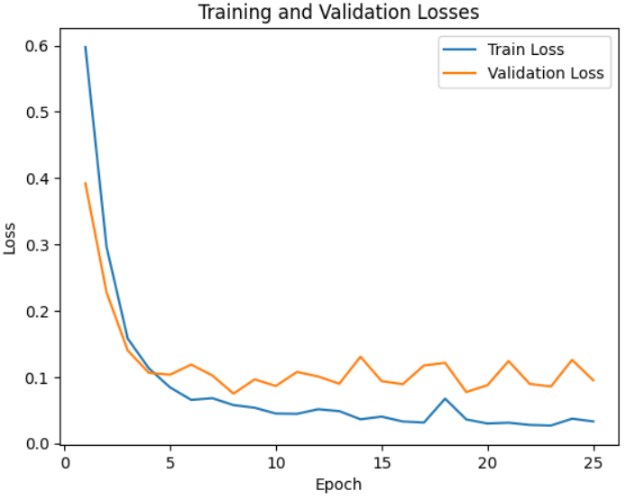
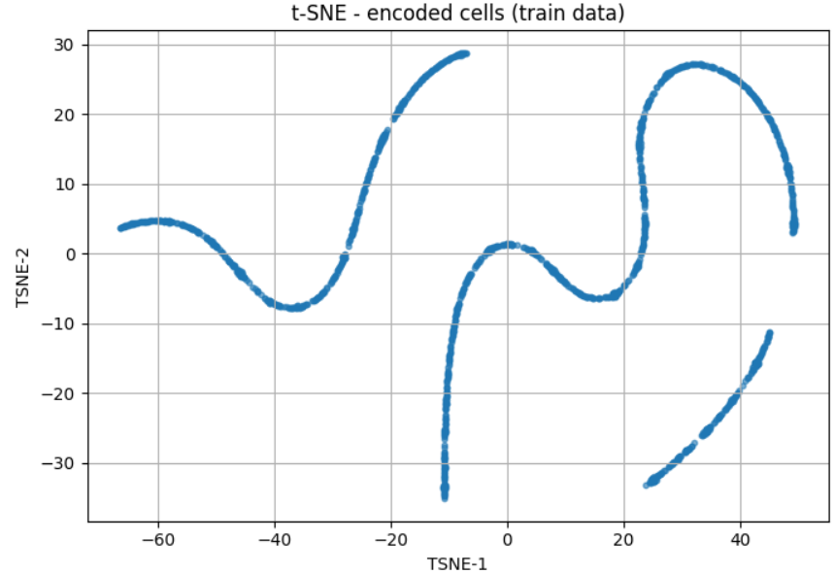
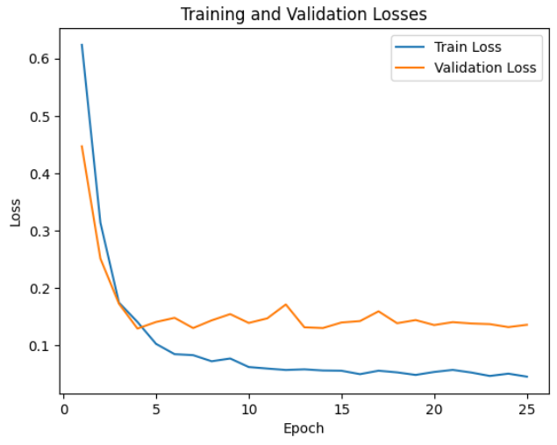
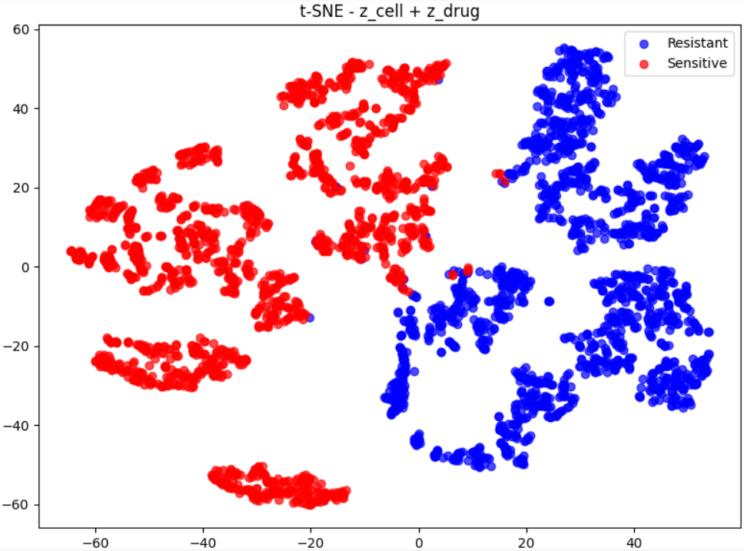
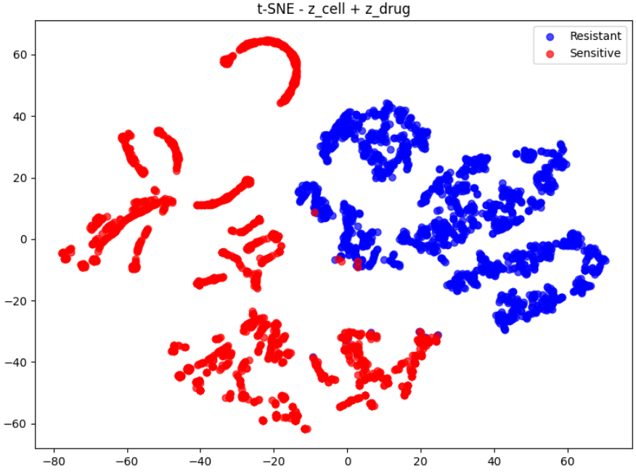
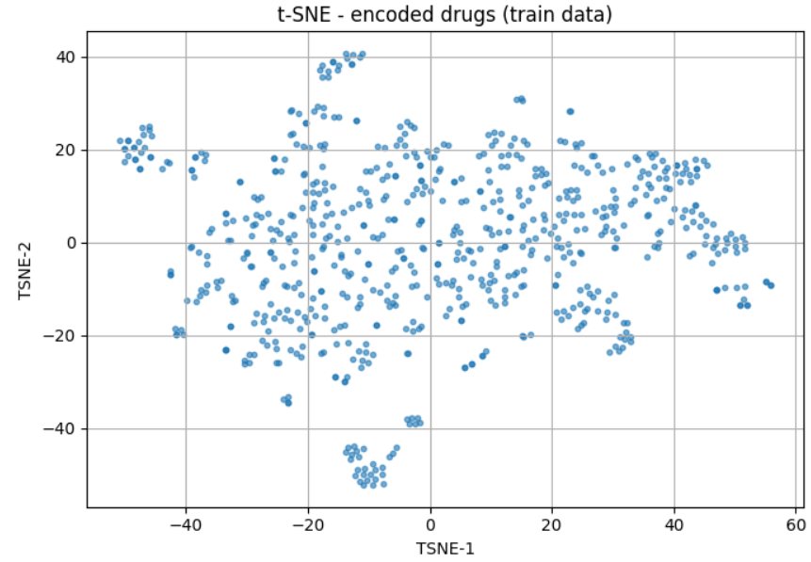
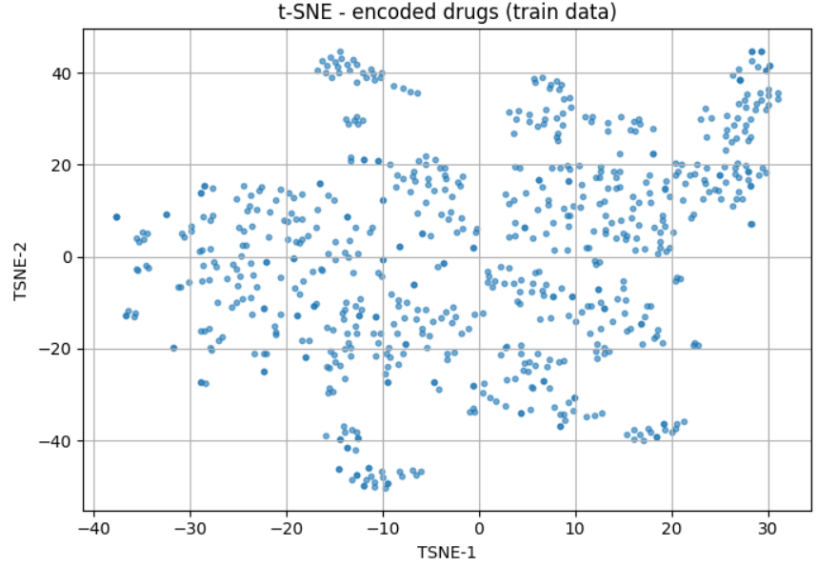
Dropout regularization
Learning rate = 0.001
Weighted MSE, alpha = 1
Tensor normalized
No Dropout
Latent dim 50/50
Learning rate = 0.001
Weighted MSE, alpha = 1
Tensor normalized
Dropout 0.1
Latent dim 50/50
None
0.1
z_cell std: 0.93
z_cell std: 0.69
z_drug std: 1.44
z_drug std: 0.96
AVG Accuracy | 0.818
AVG Precision | 0.885
AVG Recall | 0.808
AVG F1 score | 0.844
AVG AUC | 0.889
AVG AUPRC | 0.882
Std AUPRC | 0.006
AVG Accuracy | 0.811
AVG Precision | 0.878
AVG Recall | 0.803
AVG F1 score | 0.839
AVG AUC | 0.881
AVG AUPRC | 0.866
Std AUPRC | 0.005

Slide 6
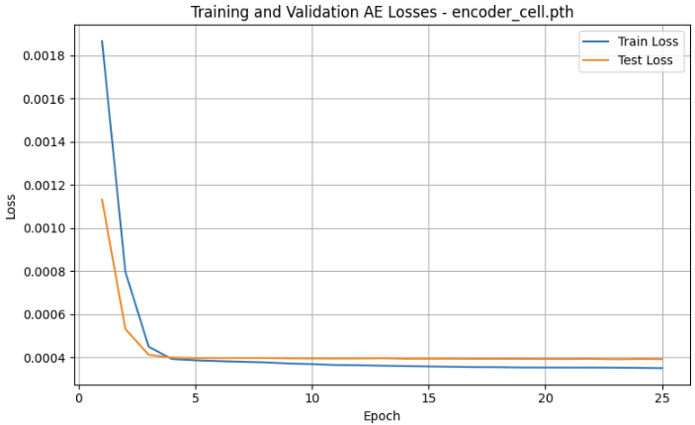
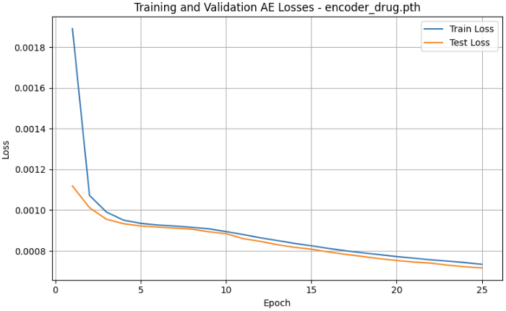
Latent dim
Learning rate = 0.001
Weighted MSE, alpha = 1
Tensor normalized
Dropout 0.1
Latent dim 50/50
Learning rate = 0.001
Weighted MSE, alpha = 1
Tensor normalized
Dropout 0.1
Latent dim 700/50
cell_latent_dim =50
cell_latent_dim =700

Slide 7
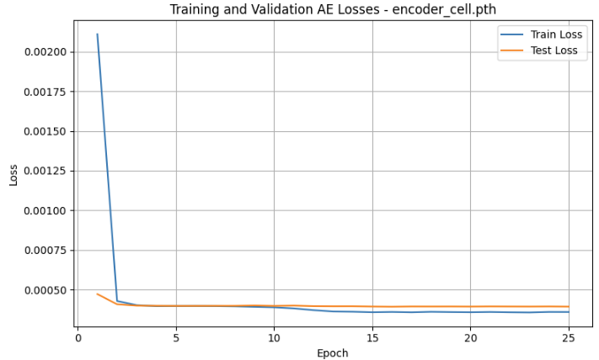
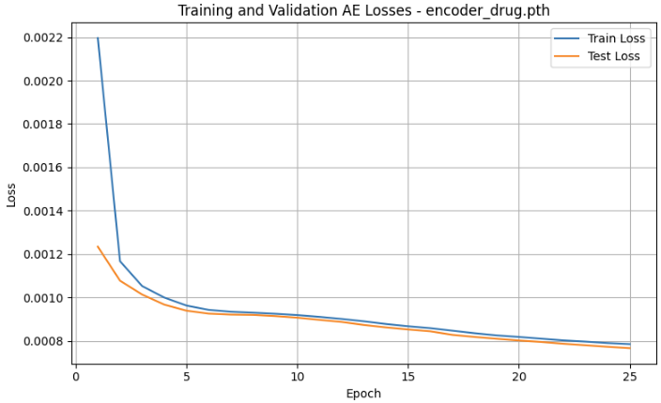
Latent dim
Learning rate = 0.001
Weighted MSE, alpha = 1
Tensor normalized
Dropout 0.1
Latent dim 50/50
Learning rate = 0.001
Weighted MSE, alpha = 1
Tensor normalized
Dropout 0.1
Latent dim 100/25
cell_latent_dim =50
drug_latent_dim =50
cell_latent_dim =100
Drug_latent_dim=25
No diff ?
Notes:
Pas de diff notable

Slide 8
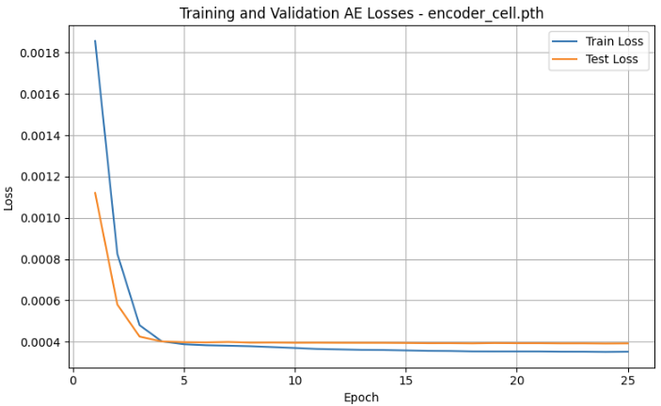
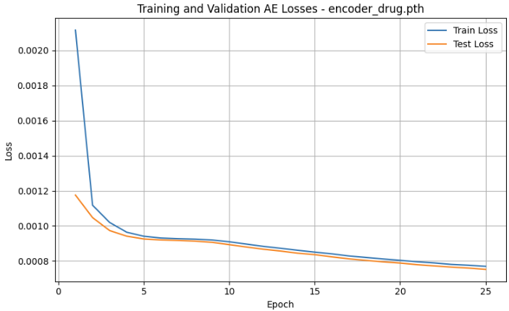
Latent dim
Learning rate = 0.001
Weighted MSE, alpha = 1
Tensor normalized
Dropout 0.1
Latent dim 50/50
Learning rate = 0.001
Weighted MSE, alpha = 1
Tensor normalized
Dropout 0.1
Latent dim 700/25
cell_latent_dim =50
drug_latent_dim =50
cell_latent_dim =700
Drug_latent_dim=25

Slide 9
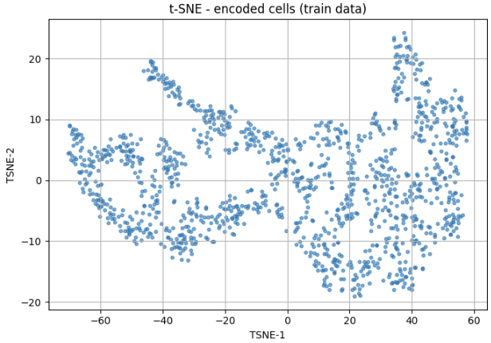
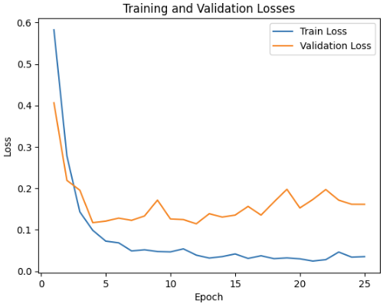
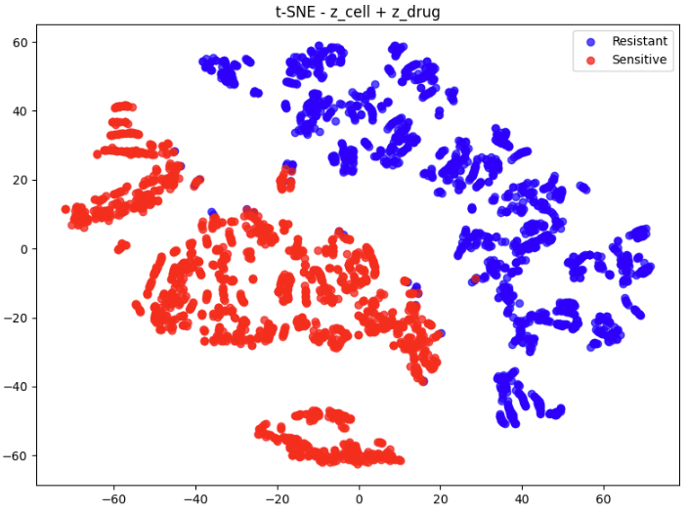
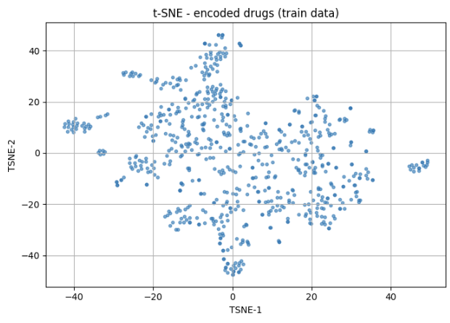
Latent dim
Learning rate = 0.001
Weighted MSE, alpha = 1
Tensor normalized
Dropout 0.1
Latent dim 50/50
Learning rate = 0.001
Weighted MSE, alpha = 1
Tensor normalized
Dropout 0.1
Latent dim 700/50
cell_latent_dim =50
cell_latent_dim =700
z_cell std: 0.69
z_cell std: 1.4
z_drug std: 0.96
z_drug std: 0.81
AVG Accuracy | 0.811
AVG Precision | 0.878
AVG Recall | 0.803
AVG F1 score | 0.839
AVG AUC | 0.881
AVG AUPRC | 0.866
Std AUPRC | 0.005
AVG Accuracy | 0.817
AVG Precision | 0.836
AVG Recall | 0.836
AVG F1 score | 0.836
AVG AUC | 0.882
AVG AUPRC | 0.873
Std AUPRC | 0.004

Slide 10
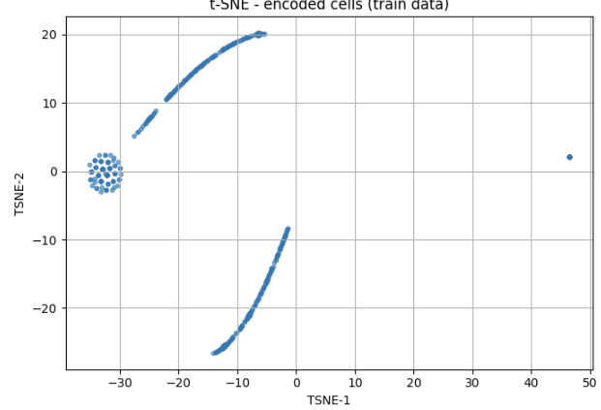
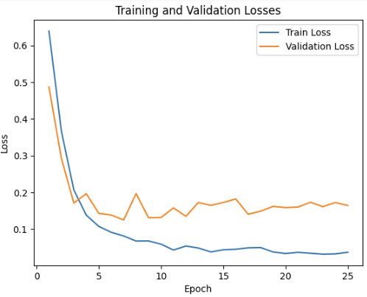
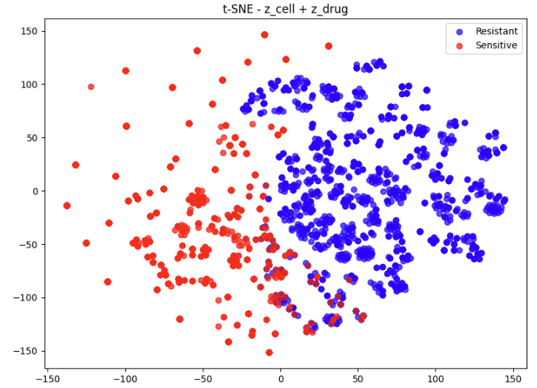
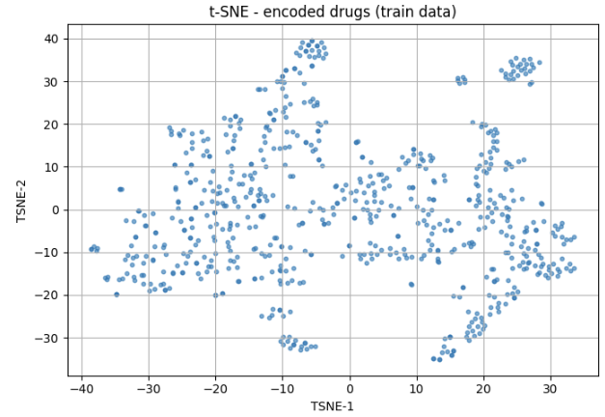
Latent dim
Learning rate = 0.001
Weighted MSE, alpha = 1
Tensor normalized
Dropout 0.1
Latent dim 50/50
Learning rate = 0.001
Weighted MSE, alpha = 1
Tensor normalized
Dropout 0.1
Latent dim 100/25
cell_latent_dim =50
drug_latent_dim =50
cell_latent_dim =100
Drug_latent_dim=25
z_cell std: 0.69
z_cell std: 0.10
z_drug std: 0.96
z_drug std: 1.03
AVG Accuracy | 0.811
AVG Precision | 0.878
AVG Recall | 0.803
AVG F1 score | 0.839
AVG AUC | 0.881
AVG AUPRC | 0.866
Std AUPRC | 0.005
AVG Accuracy | 0.804
AVG Precision | 0.809
AVG Recall | 0.835
AVG F1 score | 0.821
AVG AUC | 0.867
AVG AUPRC | 0.845
Std AUPRC | 0.017

Slide 11
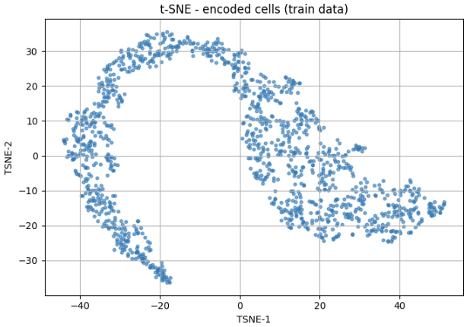
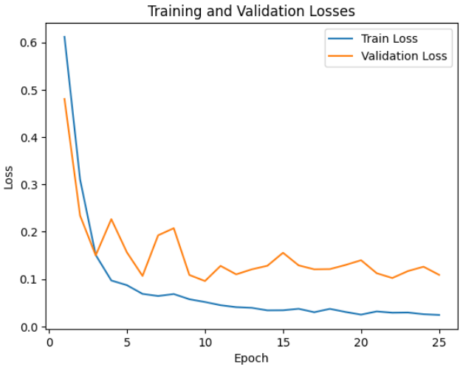
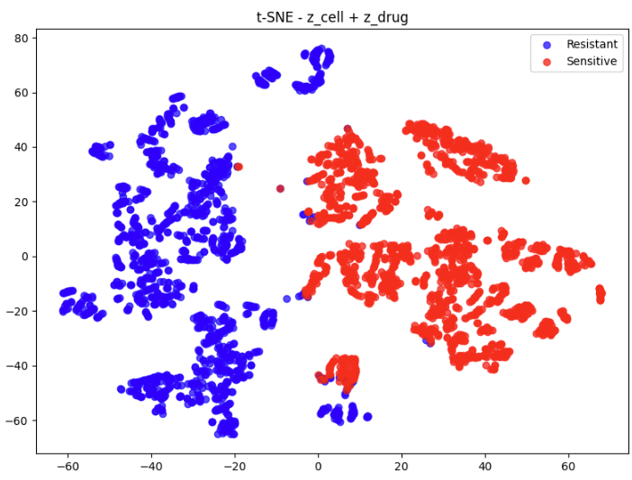
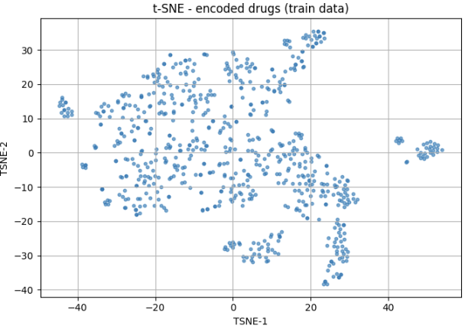
Latent dim
Learning rate = 0.001
Weighted MSE, alpha = 1
Tensor normalized
Dropout 0.1
Latent dim 50/50
Learning rate = 0.001
Weighted MSE, alpha = 1
Tensor normalized
Dropout 0.1
Latent dim 700/25
cell_latent_dim =50
drug_latent_dim =50
cell_latent_dim =700
Drug_latent_dim=25
z_cell std: 0.69
z_cell std: 3.04
z_drug std: 0.96
z_drug std: 1.04
AVG Accuracy | 0.811
AVG Precision | 0.878
AVG Recall | 0.803
AVG F1 score | 0.839
AVG AUC | 0.881
AVG AUPRC | 0.866
Std AUPRC | 0.005
AVG Accuracy | 0.797
AVG Precision | 0.769
AVG Recall | 0.852
AVG F1 score | 0.809
AVG AUC | 0.889
AVG AUPRC | 0.879
Std AUPRC | 0.011
Notes:
À verifier z_cell (alpha ??)

Slide 12
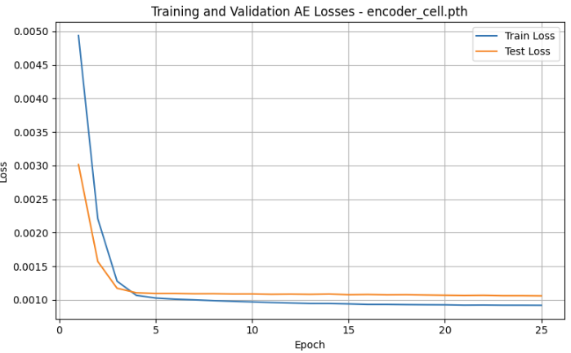
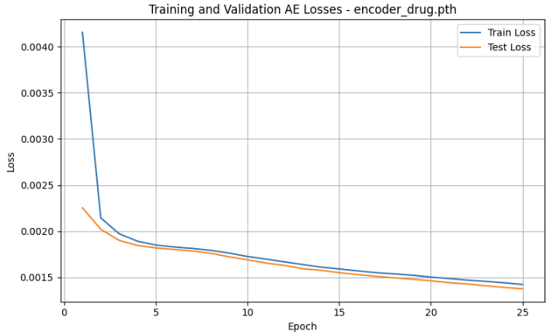
Weighted MSE
Learning rate = 0.001
Weighted MSE, alpha = 1
Tensor normalized
Dropout 0.1
Latent dim 700/50
Learning rate = 0.001
Weighted MSE, alpha = 3
Tensor normalized
Dropout 0.1
Latent dim 700/50
Alpha = 1 (standard MSE)
Alpha = 3
Notes:
❐ Essayer loss différentes pour drug et cell

Slide 13
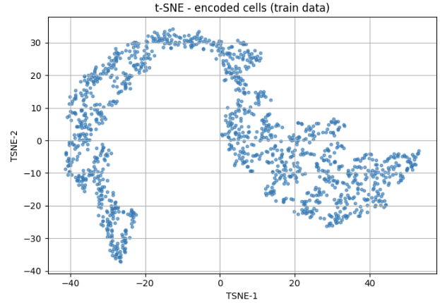
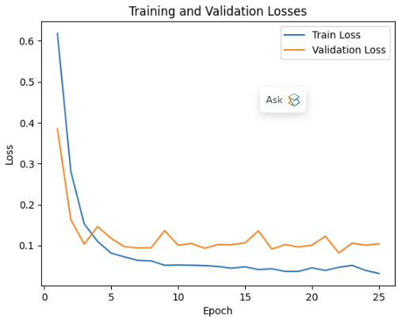
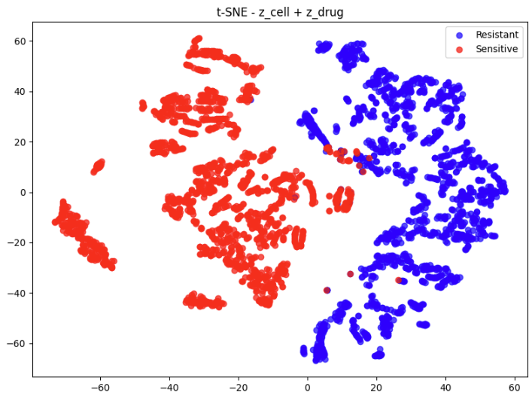
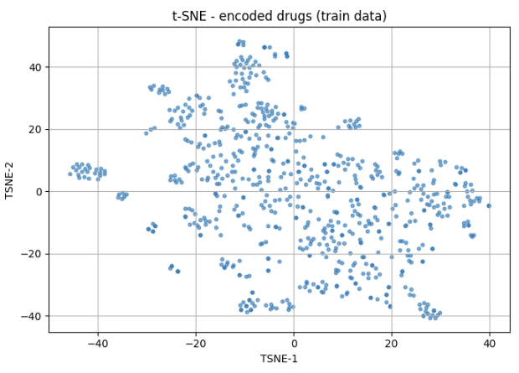
Weighted MSE
Learning rate = 0.001
Weighted MSE, alpha = 1
Tensor normalized
Dropout 0.1
Latent dim 700/50
Learning rate = 0.001
Weighted MSE, alpha = 3
Tensor normalized
Dropout 0.1
Latent dim 700/50
Alpha = 1 (standard MSE)
Alpha = 3
z_cell std: 1.4
z_cell std: 2.35
z_drug std: 0.81
z_drug std: 0.81
AVG Accuracy | 0.817
AVG Precision | 0.836
AVG Recall | 0.836
AVG F1 score | 0.836
AVG AUC | 0.882
AVG AUPRC | 0.873
Std AUPRC | 0.004
AVG Accuracy | 0.807
AVG Precision | 0.820
AVG Recall | 0.832
AVG F1 score | 0.825
AVG AUC | 0.870
AVG AUPRC | 0.859
Std AUPRC | 0.013

Slide 14
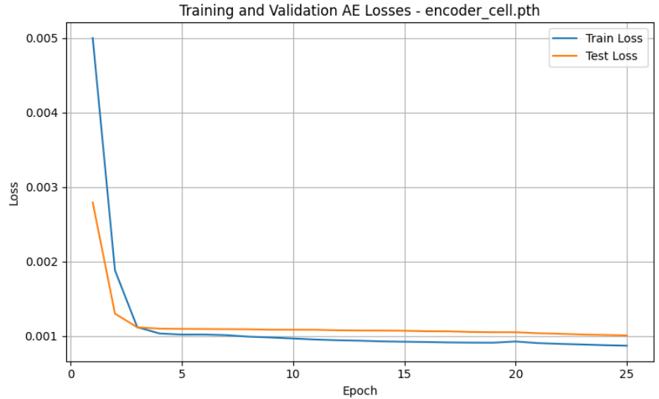
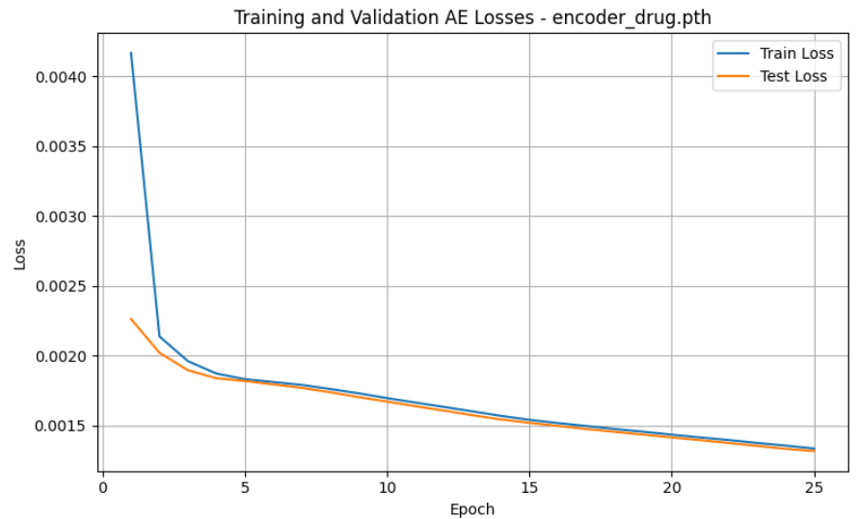
Dropout regularization
Learning rate = 0.001
Weighted MSE, alpha = 3
Tensor normalized
Dropout 0.1
Latent dim 700/50
Learning rate = 0.001
Weighted MSE, alpha = 3
Tensor normalized
No dropout
Latent dim 700/50
0.1
No Dropout

Slide 15
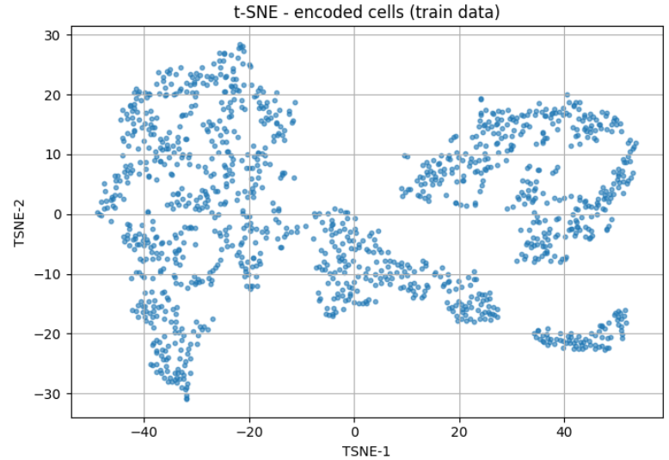
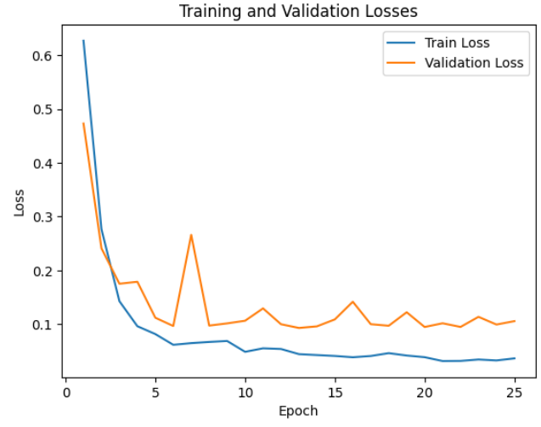
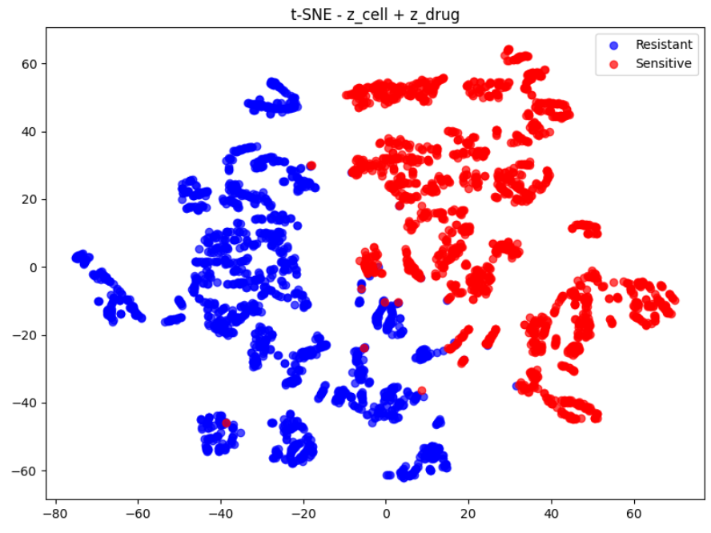
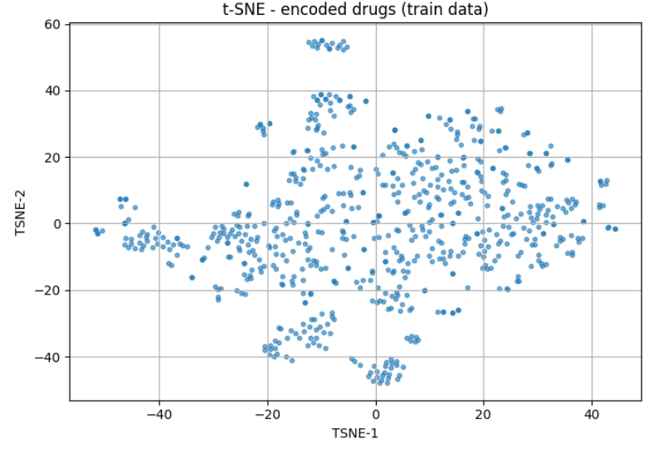
Dropout regularization
Learning rate = 0.001
Weighted MSE, alpha = 3
Tensor normalized
Dropout 0.1
Latent dim 700/50
Learning rate = 0.001
Weighted MSE, alpha = 3
Tensor normalized
No dropout
Latent dim 700/50
0.1
No Dropout
z_cell std: 2.35
z_cell std: 2.9
z_drug std: 0.81
z_drug std: 1.3
AVG Accuracy | 0.807
AVG Precision | 0.820
AVG Recall | 0.832
AVG F1 score | 0.825
AVG AUC | 0.870
AVG AUPRC | 0.859
Std AUPRC | 0.013
AVG Accuracy | 0.826
AVG Precision | 0.858
AVG Recall | 0.835
AVG F1 score | 0.847
AVG AUC | 0.877
AVG AUPRC | 0.860
Std AUPRC | 0.002

Slide 16
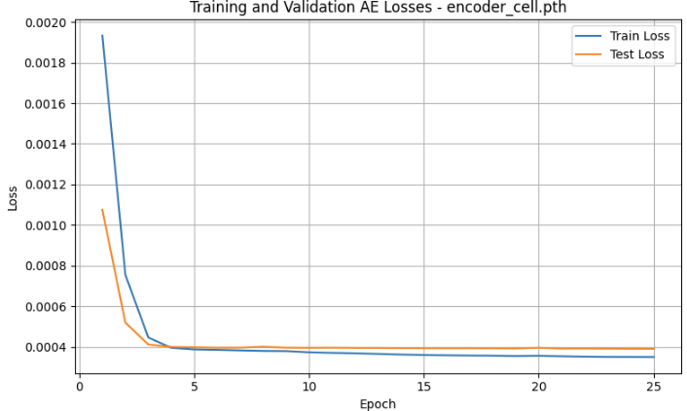
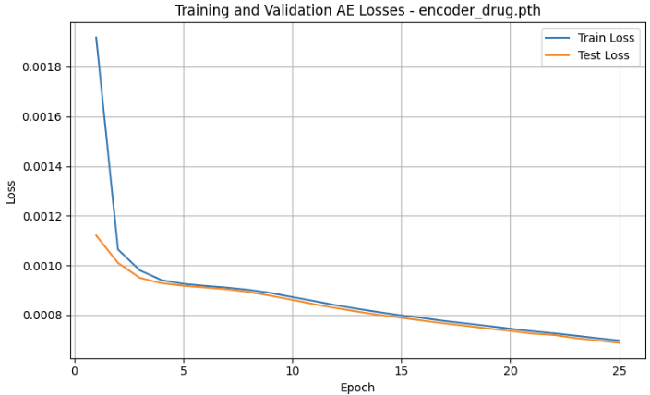
Weighted MSE
Learning rate = 0.001
Weighted MSE, alpha = 3
Tensor normalized
No dropout
Latent dim 700/50
Learning rate = 0.001
Weighted MSE, alpha = 1
Tensor normalized
No dropout
Latent dim 700/50
Alpha = 3
Alpha = 1

Slide 17




Weighted MSE
Learning rate = 0.001
Weighted MSE, alpha = 3
Tensor normalized
No dropout
Latent dim 700/50
Learning rate = 0.001
Weighted MSE, alpha = 1
Tensor normalized
No dropout
Latent dim 700/50
Alpha = 3
Alpha = 1
z_cell std: 2.9
z_cell std: 5
z_drug std: 1.3
z_drug std: 1.3
AVG Accuracy | 0.826
AVG Precision | 0.858
AVG Recall | 0.835
AVG F1 score | 0.847
AVG AUC | 0.877
AVG AUPRC | 0.860
Std AUPRC | 0.002
AVG Accuracy | 0.846
AVG Precision | 0.889
AVG Recall | 0.844
AVG F1 score | 0.865
AVG AUC | 0.902
AVG AUPRC | 0.904
Std AUPRC | 0.002
Notes:
Overfit ?

Slide 18




Latent dim 700/50 discrepancy
Learning rate = 0.001
Weighted MSE, alpha = 1
Tensor normalized
No dropout
Latent dim 700/50
Learning rate = 0.001
Weighted MSE, alpha = 1
Tensor normalized
No dropout
Latent dim 700/50
23 mai 2025
26 mai 2025
z_cell std: 5
z_cell std: 12.6
z_drug std: 1.3
AVG Accuracy | 0.846
AVG Precision | 0.889
AVG Recall | 0.844
AVG F1 score | 0.865
AVG AUC | 0.902
AVG AUPRC | 0.904
Std AUPRC | 0.002
AVG Accuracy | 0.796
AVG Precision | 0.803
AVG Recall | 0.829
AVG F1 score | 0.815
AVG AUC | 0.865
AVG AUPRC | 0.838
Std AUPRC | 0.010
Notes:
PROBLEME !

Slide 19




Latent dim 700/25 discrepancy
Learning rate = 0.001
Weighted MSE, alpha = 1
Tensor normalized
Dropout 0.1
Latent dim 700/25
Learning rate = 0.001
Weighted MSE, alpha = 1
Tensor normalized
Dropout 0.1
Latent dim 700/25
23 mai 2025
27 mai 2025
z_cell std: 3.04
z_cell std: 1.12
z_drug std: 1.04
z_drug std: 1.12
AVG Accuracy | 0.797
AVG Precision | 0.769
AVG Recall | 0.852
AVG F1 score | 0.809
AVG AUC | 0.889
AVG AUPRC | 0.879
Std AUPRC | 0.011
AVG Accuracy | 0.818
AVG Precision | 0.826
AVG Recall | 0.845
AVG F1 score | 0.835
AVG AUC | 0.872
AVG AUPRC | 0.847
Std AUPRC | 0.008
Notes:
PROBLEME !

Slide 20


ZINB loss
Learning rate = 0.001
Weighted MSE, alpha = 1
Tensor normalized
Dropout 0.1
Latent dim 700/50
Learning rate = 0.001
ZINB loss
Tensor normalized
Dropout 0.1
Latent dim 700/50
Alpha = 1 (standard MSE)
ZINB
Notes:
Pas de diff notable

Slide 21




ZINB loss
Learning rate = 0.001
Weighted MSE, alpha = 1
Tensor normalized
Dropout 0.1
Latent dim 700/50
Learning rate = 0.001
ZINB loss
Tensor normalized
Dropout 0.1
Latent dim 700/50
Alpha = 1 (standard MSE)
ZINB
z_cell std: 1.4
z_cell std: 22.8
z_drug std: 17.08
z_drug std: 0.81
AVG Accuracy | 0.817
AVG Precision | 0.836
AVG Recall | 0.836
AVG F1 score | 0.836
AVG AUC | 0.882
AVG AUPRC | 0.873
Std AUPRC | 0.004
AVG Accuracy | 0.793
AVG Precision | 0.800
AVG Recall | 0.826
AVG F1 score | 0.810
AVG AUC | 0.873
AVG AUPRC | 0.879
Std AUPRC | 0.002
Notes:
Vérifier ZINB. Tester des paramètres différents ??
Essayer loss différentes pour chaque AE
ZINB loss (Zero-Inflated Negative Binomial) pour entraîner tes autoencodeurs peut être très pertinent, en particulier si tes données sont fortement clairsemées (sparse), comme c’est le cas pour :
cell_mut (mutations binaires ou quasi-binaires, très clairsemées)
drug_finger (empreintes moléculaires binaires, très sparse aussi)
La ZINB est un modèle de probabilité adapté à des comptes discrets surdispersés avec excès de zéros.
Il modélise la probabilité d’observer un zéro comme provenant de deux sources :
Un "processus de dropout" (zéro structurel : le gène n’est jamais exprimé / la mutation n’a jamais lieu)
Un processus NB (zéro attendu par une distribution NB avec un taux bas)
Forme de la ZINB loss : Elle dépend de 3 paramètres que le modèle doit prédire pour chaque feature :
μ : moyenne (intensité)
θ : dispersion
π : probabilité que l’observation soit un "zéro excès" (dropout)
✅ Adapté à des données comme cell_mut ou drug_finger
Ces données sont extrêmement binaires ou quasi-binaires, avec énormément de zéros (mutations absentes / bit non activé).
Les reconstructions classiques avec MSE ou même binary cross-entropy n’exploitent pas la structure probabiliste sous-jacente, surtout la dualité entre "zéro attendu" et "zéro par dropout".
✅ Apprentissage plus robuste
Le modèle n’est pas pénalisé à outrance pour reconstruire des zéros, car il apprend à distinguer les zéros "réels" des zéros "dropoutés".
✅ Latents plus informatifs
ZINB encourage des représentations moins triviales, surtout en combinant μ, θ, π → cela enrichit la structure latente.

Slide 22








Test on TCGA
cell_exp cell_mut
Learning rate = 0.001
Weighted MSE, alpha = 3
Tensor normalized
Dropout 0.1
Latent dim 700/50
AVG Accuracy | 0.785
AVG Precision | 0.833
AVG Recall | 0.793
AVG F1 score | 0.812
AVG AUC | 0.865
AVG AUPRC | 0.860
Std AUPRC | 0.003
z_cell std: 0.68
z_drug std: 0.82
AVG Accuracy | 0.489
AVG Precision | 0.375
AVG Recall | 0.103
AVG F1 score | 0.162
AVG AUC | 0.406
AVG AUPRC | 0.875
Table 8. Results of training model on CTRP+GDSC and test on TCGA using gene expression and drug data.

Slide 23







Test on TCGA
cell_exp
Learning rate = 0.001
Weighted MSE, alpha = 3
Tensor normalized
Dropout 0.1
Latent dim 700/50
AVG Accuracy | 0.804
AVG Precision | 0.865
AVG Recall | 0.799
AVG F1 score | 0.830
AVG AUC | 0.878
AVG AUPRC | 0.878
Std AUPRC | 0.002
z_cell std: 0.33
z_drug std: 0.82
AVG Accuracy | 0.518
AVG Precision | 0.444
AVG Recall | 0.385
AVG F1 score | 0.412
AVG AUC | 0.519
AVG AUPRC | 0.627

Slide 24







Test on TCGA
cell_exp
Learning rate = 0.001
Weighted MSE, alpha = 1
Tensor normalized
Dropout 0.1
Latent dim 700/50
AVG Accuracy | 0.797
AVG Precision | 0.874
AVG Recall | 0.788
AVG F1 score | 0.828
AVG AUC | 0.869
AVG AUPRC | 0.856
Std AUPRC | 0.002
z_cell std: 0.30
AVG Accuracy | 0.521
AVG Precision | 0.462
AVG Recall | 0.391
AVG F1 score | 0.423
AVG AUC | 0.535
AVG AUPRC | 0.647
z_drug std: 0.84

Slide 25







Test on TCGA
cell_exp
Learning rate = 0.001
Weighted MSE, alpha = 1
Tensor normalized
Dropout 0.05
Latent dim 700/50
AVG Accuracy | 0.787
AVG Precision | 0.878
AVG Recall | 0.780
AVG F1 score | 0.822
AVG AUC | 0.882
AVG AUPRC | 0.862
Std AUPRC | 0.011
z_cell std: 0.32
AVG Accuracy | 0.512
AVG Precision | 0.421
AVG Recall | 0.374
AVG F1 score | 0.396
AVG AUC | 0.531
AVG AUPRC | 0.645
z_drug std: 1.05

Slide 26







Test on TCGA
cell_exp
Learning rate = 0.001
Weighted MSE, alpha = 1
Tensor normalized
Dropout 0.05
Latent dim 500/50
AVG Accuracy | 0.774
AVG Precision | 0.894
AVG Recall | 0.751
AVG F1 score | 0.816
AVG AUC | 0.858
AVG AUPRC | 0.837
Std AUPRC | 0.015
z_cell std: 0.29
z_drug std: 0.99
AVG Accuracy | 0.504
AVG Precision | 0.393
AVG Recall | 0.360
AVG F1 score | 0.376
AVG AUC | 0.530
AVG AUPRC | 0.667

Slide 27







Test on TCGA
cell_exp
Learning rate = 0.001
Weighted MSE, alpha = 1
Tensor normalized
No Dropout
Latent dim 700/50
AVG Accuracy | 0.781
AVG Precision | 0.882
AVG Recall | 0.766
AVG F1 score | 0.818
AVG AUC | 0.855
AVG AUPRC | 0.844
Std AUPRC | 0.005
z_cell std: 0.98
z_drug std: 1.20
AVG Accuracy | 0.486
AVG Precision | 0.482
AVG Recall | 0.367
AVG F1 score | 0.417
AVG AUC | 0.519
AVG AUPRC | 0.660

Slide 28







Test on TCGA
cell_exp
Learning rate = 0.001
Weighted MSE, alpha = 1
Tensor normalized
Dropout 0.2
Latent dim 700/50
AVG Accuracy | 0.812
AVG Precision | 0.870
AVG Recall | 0.813
AVG F1 score | 0.836
AVG AUC | 0.892
AVG AUPRC | 0.891
Std AUPRC | 0.003
z_cell std: 0.39
z_drug std: 0.68
AVG Accuracy | 0.508
AVG Precision | 0.416
AVG Recall | 0.369
AVG F1 score | 0.391
AVG AUC | 0.520
AVG AUPRC | 0.637

Slide 29






Test on TCGA
cell_exp
Learning rate = 0.001
Weighted MSE, alpha = 1
Tensor normalized
Dropout 0.2
Latent dim 1000/50
AVG Accuracy | 0.799
AVG Precision | 0.846
AVG Recall | 0.805
AVG F1 score | 0.825
AVG AUC | 0.862
AVG AUPRC | 0.845
Std AUPRC | 0.016
z_cell std: 0.43
z_drug std: 0.72
AVG Accuracy | 0.491
AVG Precision | 0.447
AVG Recall | 0.363
AVG F1 score | 0.400
AVG AUC | 0.513
AVG AUPRC | 0.618

Slide 30







Test on TCGA
cell_exp
Learning rate = 0.001
Weighted MSE, alpha = 3
Tensor normalized
Dropout 0.2
Latent dim 700/50
AVG Accuracy | 0.785
AVG Precision | 0.933
AVG Recall | 0.747
AVG F1 score | 0.829
AVG AUC | 0.874
AVG AUPRC | 0.854
Std AUPRC | 0.009
z_cell std: 0.24
z_drug std: 0.62
AVG Accuracy | 0.493
AVG Precision | 0.530
AVG Recall | 0.381
AVG F1 score | 0.443
AVG AUC | 0.519
AVG AUPRC | 0.620

Slide 31












DeepDRA
Training set : CTRP-GDSC
Test set : TCGA
Learning rate = 0.001
Weighted MSE, alpha = 1
No dropout
Latent dim 50/50
z_cell std: 1.40
MLP classification
on CCLE test set
z_drug std: 1.36
AVG Accuracy | 0.783
AVG Precision | 0.869
AVG Recall | 0.775
AVG F1 score | 0.817
AVG AUC | 0.867
AVG AUPRC | 0.853
Std AUPRC | 0.010
AVG Accuracy | 0.464
AVG Precision | 0.555
AVG Recall | 0.367
AVG F1 score | 0.439
AVG AUC | 0.523
AVG AUPRC | 0.644
Std AUPRC | 0.016
MLP classification on TCGA
AVG Accuracy | 0.509
AVG Precision | 0.462
AVG Recall | 0.380
AVG F1 score | 0.417
AVG AUC | 0.526
AVG AUPRC | 0.648
Std AUPRC | 0.000
TP | FP
FN | TN

Slide 32








Learning rate = 0.001
Weighted MSE, alpha = 1
Dropout 10%
Latent dim 700/50
z_cell std: 0.36
MLP classification
on CCLE test set
AVG Accuracy | 0.789
AVG Precision | 0.876
AVG Recall | 0.778
AVG F1 score | 0.823
AVG AUC | 0.865
AVG AUPRC | 0.854
Std AUPRC | 0.013
z_drug std: 0.84
MLP classification on TCGA
AVG Accuracy | 0.520
AVG Precision | 0.452
AVG Recall | 0.388
AVG F1 score | 0.417
AVG AUC | 0.535
AVG AUPRC | 0.637
Std AUPRC | 0.000
TP | FP
FN | TN
Notes:
Si je fais le undersampler sur script 3 AUPRC serait meilleur ?

Slide 33








Learning rate = 0.001
Weighted MSE, alpha = 3
Dropout 10%
Latent dim 700/50
z_cell std: 0.35
MLP classification
on CCLE test set
z_drug std: 0.85
AVG Accuracy | 0.785
AVG Precision | 0.875
AVG Recall | 0.774
AVG F1 score | 0.820
AVG AUC | 0.868
AVG AUPRC | 0.858
Std AUPRC | 0.010
MLP classification on TCGA
AVG Accuracy | 0.513
AVG Precision | 0.421
AVG Recall | 0.375
AVG F1 score | 0.397
AVG AUC | 0.523
AVG AUPRC | 0.621
Std AUPRC | 0.000
TP | FP
FN | TN

Slide 34



Learning rate = 0.001
Weighted MSE, alpha = 1
Dropout 10%
Latent dim 700/50
Script test_on_TCGA.py
Without RandomUnderSampler
AVG Accuracy | 0.514
AVG Precision | 0.462
AVG Recall | 0.516
AVG F1 score | 0.487
AVG AUC | 0.540
AVG AUPRC | 0.551
Std AUPRC | 0.000
Script fine_tune_TCGA.py
train_len = int(0.00966 * len(dataset))
Taille du set de fine-tuning (train_len): 10
Taille du set de validation (test_len): 1026
AVG Accuracy | 0.551
AVG Precision | 0.636
AVG Recall | 0.643
AVG F1 score | 0.640
AVG AUC | 0.499
AVG AUPRC | 0.642
Std AUPRC | 0.000

Slide 35




Learning rate = 0.001
Weighted MSE, alpha = 1
Dropout 10%
Latent dim 700/50
Taille du set de fine-tuning (train_len): 99
Taille du set de validation (test_len): 937
AVG Accuracy | 0.674
AVG Precision | 0.698
AVG Recall | 0.845
AVG F1 score | 0.764
AVG AUC | 0.650
AVG AUPRC | 0.739
Std AUPRC | 0.000
train_len = int(0.2 * len(dataset))
Taille du set de fine-tuning (train_len): 207
Taille du set de validation (test_len): 829
AVG Accuracy | 0.721
AVG Precision | 0.706
AVG Recall | 0.950
AVG F1 score | 0.810
AVG AUC | 0.699
AVG AUPRC | 0.744
Std AUPRC | 0.000

Slide 36




Learning rate = 0.001
Weighted MSE, alpha = 1
Dropout 10%
Latent dim 700/50
train_len = int(0.38 * len(dataset))
Taille du set de fine-tuning (train_len): 393
Taille du set de validation (test_len): 643
AVG Accuracy | 0.740
AVG Precision | 0.763
AVG Recall | 0.838
AVG F1 score | 0.799
AVG AUC | 0.755
AVG AUPRC | 0.804
Std AUPRC | 0.000
train_len = int(0.65 * len(dataset))
Taille du set de fine-tuning (train_len): 673
Taille du set de validation (test_len): 363
AVG Accuracy | 0.716
AVG Precision | 0.698
AVG Recall | 0.951
AVG F1 score | 0.805
AVG AUC | 0.788
AVG AUPRC | 0.828
Std AUPRC | 0.000

Slide 37







With RandomUnderSampler
0 samples
5 samples
Accuracy | 0.510
Precision | 0.462
Recall | 0.511
F1 score | 0.485
AUC | 0.534
AUPRC | 0.536
10 samples
20 samples

Slide 38








100 samples
50 samples
200 samples
400 samples

Slide 39







600 samples
500 samples
700 samples

Slide 40


1 modality : gene expression level vs.
2 modalities : gene expression level and mutations

Slide 41

2 modalities : gene expression level and mutations
MSE vs. ZINB

Slide 43




Dropout regularization
Learning rate = 0.001
Weighted MSE, alpha = 3
Tensor normalized
No Dropout
Latent dim 700/50
Slide 38
Learning rate = 0.001
Weighted MSE, alpha = 3
Tensor normalized
Dropout 0.1
Latent dim 700/50
Slide 40
z_cell std: 5.033831596374512 z_drug std: 1.2838635444641113
z_cell std: 1.8434468507766724 z_drug std: 0.8110901117324829
AVG Accuracy | 0.819
AVG Precision | 0.871
AVG Recall | 0.819
AVG F1 score | 0.843
AVG AUC | 0.878
AVG AUPRC | 0.871
Std AUPRC | 0.005
AVG Accuracy | 0.824
AVG Precision | 0.844
AVG Recall | 0.841
AVG F1 score | 0.842
AVG AUC | 0.893
AVG AUPRC | 0.886
Std AUPRC | 0.013

Slide 44
Normalization of tensors
None
torch.nn.functional.normalize
Learning rate = 0.001
Weighted MSE, alpha = 10
No tensor normalization
Dropout 0.05
Latent dim 50/50
Slide 20
Learning rate = 0.001
Weighted MSE, alpha = 5
Tensor normalized
No dropout
Latent dim 100/25
Slide 26
Learning rate = 0.001
Weighted MSE, alpha = 5
No tensor normalization
No dropout
Latent dim 100/25
Slide 24

Slide 45
Latent dim
Cells
Drugs
Learning rate = 0.001
Weighted MSE, alpha = 10
Tensor NOT normalized
Dropout 0.05
Latent dim 50/50
Slide 20
25
50
Learning rate = 0.001
Weighted MSE, alpha = 5
Tensor NOT normalized
No dropout
Latent dim 100/25
Slide 24
50
100
500
Learning rate = 0.001
Weighted MSE, alpha = 5
Tensor normalized
No dropout
Latent dim 700/50
Slide 34
Learning rate = 0.001
Weighted MSE, alpha = 5
Tensor normalized
No dropout
Latent dim 1000/50
Slide 32
Learning rate = 0.001
Weighted MSE, alpha = 5
Tensor normalized
No dropout
Latent dim 500/50
Slide 36
700
1000

Slide 46
Best MLP results at the moment
AVG Accuracy 0.824
AVG Accuracy 0.822
AVG Accuracy 0.819
AVG Accuracy 0.818
Learning rate = 0.001
Weighted MSE, alpha = 3
Dropout regularization 0.1
normalization of tensors
Cell latent_dim = 700
Drug latent_dim = 50
Learning rate = 0.001
Weighted MSE, alpha = 5
Dropout regularization 0.05
# no normalization of tensors
Cell latent_dim = 100
Drug latent_dim = 25
Learning rate = 0.001
Weighted MSE, alpha = 3
No Dropout regularization
normalization of tensors
Cell latent_dim = 700
Drug latent_dim = 50
Learning rate = 0.001
Weighted MSE, alpha = 5
No Dropout regularization
normalization of tensors
Cell latent_dim = 700
Drug latent_dim = 50

